Slide 1
Obsessive Compulsive Disorder and SLC6A4
Picture: http://www.axisresidentialtreatment.com/obsessive-compulsive-disorder/
m
o
Maisie Steinbrink

Slide 2
Game Plan
What is OCD? What causes it?
SLC6A4 and its characteristics
Specific aims and future research
https://kiltsdjembesandredboots.wordpress.com/

Slide 3
The OCD Cycle
Obsessions
Relief
Anxiety
http://www.anxietydisorderhelp.net/
Compulsions
http://www.youbeauty.com/mind/columns/cloud-nine/calm-the-mind
http://emojipedia.org/relieved-face/
http://www.guelphtherapist.ca/blog/letting-go-of-thoughts-mindfully/
http://myconfidential.blogspot.com/
http://alegnasolutions.com.au/services/psychology/psychologist-gold-coast-anxiety/obsessive-compulsive-disorder/

Slide 4
This obsession doesn’t count ☺
X
http://www.fanpop.com/clubs/one-direction/images/32752102/title/one-direction-2012-photo

Slide 5
What genes are involved? LOTS!
5HT2A
5HT1-D beta
OCD
DRD4
SLC6A4
MAO-A
OLIG2
OCD is a polygenic disorder
STRING: http://string-db.org/

Slide 6
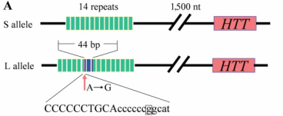
SLC6A4 and OCD
STin9, STin10, STin12
5-HTTLPR: S, LA, and LG
http://www.bio.davidson.edu/Courses/genomics/2004/Cobain/angergene.html

Slide 7
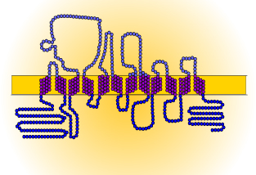
SLC6A4 and OCD
STin9, STin10, STin12
5-HTTLPR: S, LA, and LG
Extracellular
Cytoplasm
Transmembrane Domain
5-HT Transport Domain
http://www.bio.davidson.edu/Courses/genomics/2004/Cobain/angergene.html

Slide 8
How well is SLC6A4 conserved?
100%
99%
93%
92%
78%
70%
55%
5-HT Transport Domain
Transmembrane Domain
InterPro: http://www.ebi.ac.uk/interpro/

Slide 9
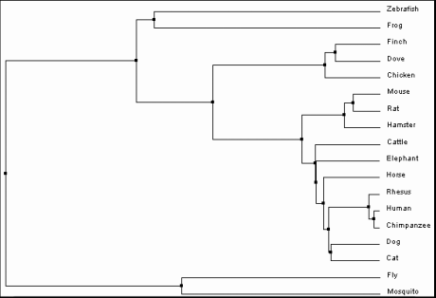
Phylogeny – Only in Kingdom Animalia
ClustalOmega: http://www.ebi.ac.uk/Tools/msa/clustalo/

Slide 10
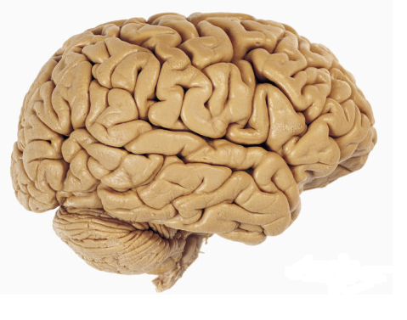
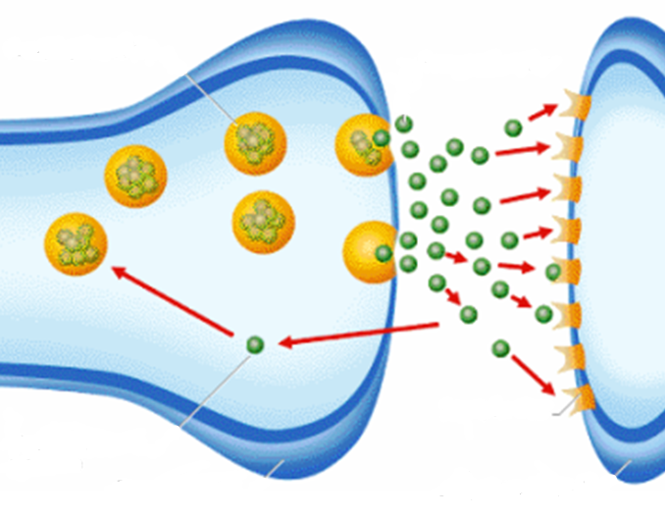
Characteristics of SLC6A4
Serotonin Binding and Reuptake
Brain Development
Synaptosome
Memory
Cocaine Binding
Cytoplasm
Plasma Membrane
Circadian Rhythm
Biological Process
Molecular Function
Cellular Component
Gene Ontology Consortium: http://geneontology.org/
http://www.gladstoneinstitutes.org/node/11312
http://www.psych2go.net/unconsciousness-neurotransmitters/
http://healthadviser24.blogspot.com/2012/08/neurotransmitters-chemical-messenger-of.html
http://www.allposters.com/-sp/Lateral-View-of-the-Human-Brain-Showing-the-Cerebrum-and-Cerebellum-Posters_i8999883_.htm

Slide 11
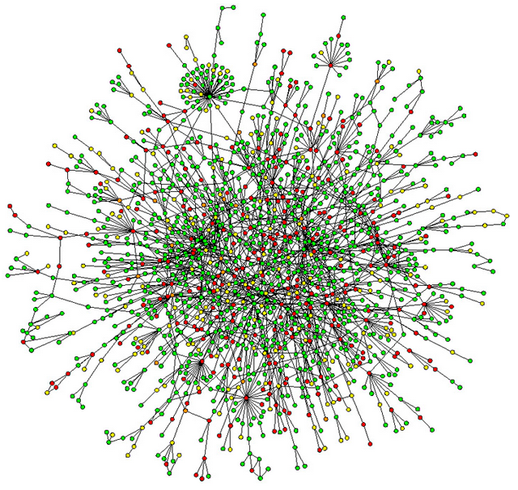
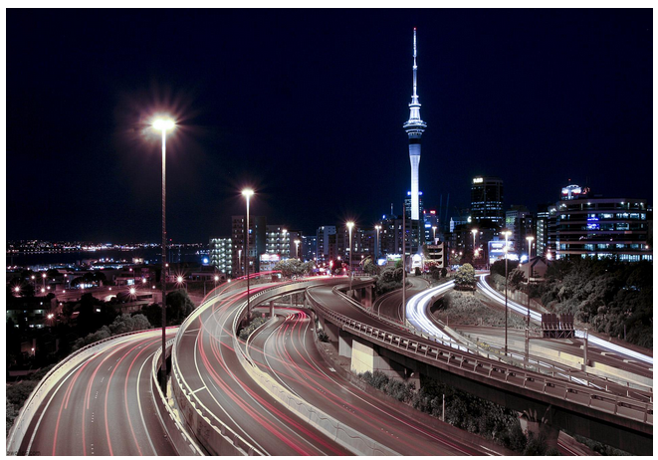
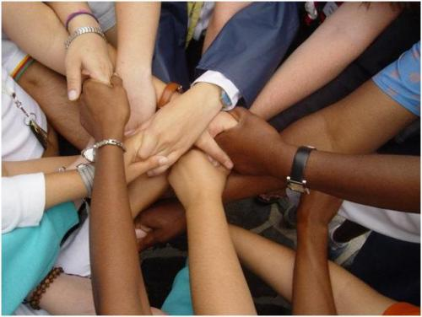
But there is still a long way to go…
OCD is polygenic
Heritability is only 0.5
http://analytical.wikia.com/wiki/Proteome?file=Proteome.jpg
http://www.koreaittimes.com/image/environment
http://fabandfru.com/2011/06/meet-up-for-business-or-pleasure/

Slide 12
Primary Goal: Determine complex interactions between SLC6A4 and other proteins as they relate to development of OCD
Hypothesis:
Kinase
Protein A
Protein C
Protein B
http://accelrys.com/products/pipeline-pilot/component-collections/gene-expression.html
http://www.igece.org/Immunology/ImmArray/

Slide 13
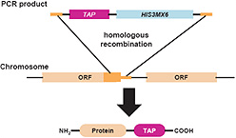
Aim 1: Identify novel and conserved SLC6A4 interacting proteins
Hypothesis: Many undiscovered interactions will be found because of the sensitivity of TAP tag approaches
http://dharmacon.gelifesciences.com/non-mammalian-cdna-and-orf/yeast-tap-tagged-orfs/

Slide 14
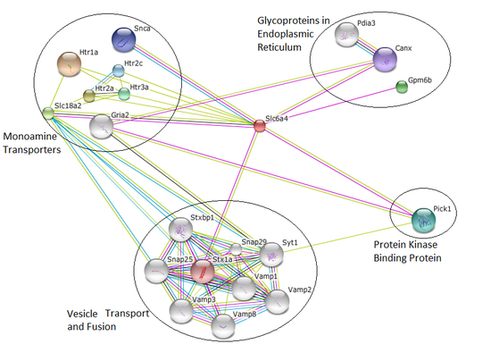
Potential outcomes Aim 1?

Slide 15
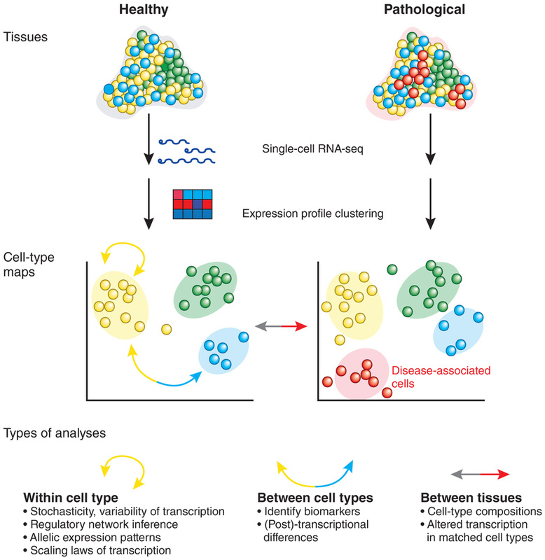
Aim 2: Identify genes that are misregulated in SLC6A4 mutant rats
Hypothesis: Genes linked to signaling and modification GO terms will be under-expressed in SLC6A4 mutant rats
http://www.scq.ubc.ca/the-yeast-two-hybrid-assay-an-exercise-in-experimental-eloquence/

Slide 16
Potential outcomes of Aim 2?
Brain Development
Brain Development
Memory
Memory
Circadian Rhythm
Circadian Rhythm
Signaling and Modification
Healthy
Mutant
http://genetics564.weebly.com/gene-expression-analysis.html

Slide 17
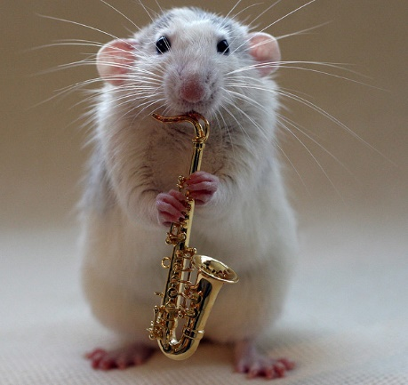
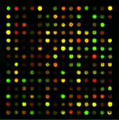
Aim 3: Determine how environmental factors alter the neuronal proteome
Hypothesis: Environmental stressors on healthy mice will cause their proteomes to change and approximate mutant proteomes
http://www.telegraph.co.uk/news/earth/earthpicturegalleries/5893236/Talented-musical-rats-strike-up-a-tune-with-their-miniature-instruments.html
https://www.pinterest.com/pin/138978338473671818/

Slide 18
Potential outcomes of Aim 3?
Healthy Stressed Mutant
vs. Healthy vs. Healthy

Slide 19
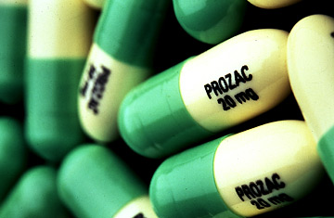
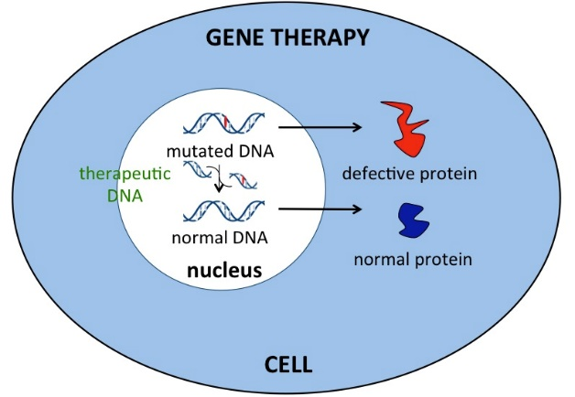
Where do we go from here?
Improved Medications
Gene Therapy Treatments
Bettering Lives!
http://content.time.com/time/health/article/0,8599,1717306,00.html
http://www.awaremed.com/gene-therapy-epigenetic-gene-therapy/
http://www.mactrast.com/2014/11/racially-diverse-emoji-way-mid-2015/

Slide 20
References
[1] Kring, A., & Johnson, S. (2013). Obsessive-Compulsive and Related Disorders. In Abnormal Psychology (12th ed. ed., DSM-5 Update, pp. 202-213). Hoboken, N.J.: John Wiley & Sons.
[2] Nestadt, G., Grados, M., & Samuels, J. (2010). Genetics of OCD. Psychiatr Clin North Am, 33(1), 141-158. Retrieved April 15, 2015, from http://www.ncbi.nlm.nih.gov/pmc/articles/PMC2824902/
[3] SLC6A4 - Sodium-dependent serotonin transporter - Homo sapiens (Human). (n.d.). Retrieved February 19, 2015, from http://www.uniprot.org/uniprot/P31645
[4] Ogilvie, A., Battersby, S., Fink, G., Harmar, A., Goodwin, G., Bubb, V., & Smith, C. (1996). Polymorphism in serotonin transporter gene associated with susceptibility to major depression. The Lancet, 347(9003), 731-733. Retrieved February 18, 2015, from http://www.sciencedirect.com.ezproxy.library.wisc.edu/science/article/pii/S0140673696900793
[5] Nakamura, M., Ueno, S., Sano, A., & Tanabe, H. (2000). The human serotonin transporter gene linked polymorphism (5-HTTLPR) shows ten novel allelic variants. Molecular Psychiatry, 5(1), 32-38. Retrieved February 19, 2015, from http://www.nature.com/mp/journal/v5/n1/full/4000698a.html
[6] STRING: http://string-db.org/
[7] BLAST: http://blast.ncbi.nlm.nih.gov/Blast.cgi
[8] Gene Ontology Consortium: http://geneontology.org/

