Slide 1
Obsessive Compulsive Disorder and SLC6A4
m
o
Maisie Steinbrink

Slide 2
Game Plan
What is OCD? What causes it?
SLC6A4 and its characteristics
Specific aims and future research

Slide 3
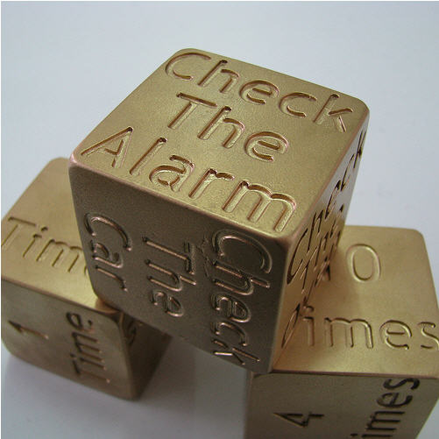
The OCD Cycle
Obsessions
Relief
Anxiety
Compulsions

Slide 4
This obsession doesn’t count ☺
X

Slide 5
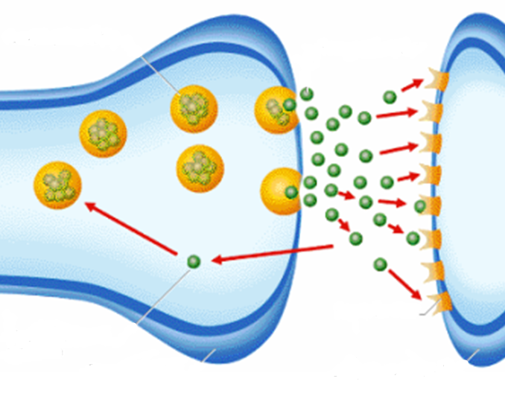
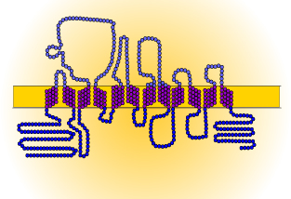
SLC6A4 and OCD
Extracellular
Cytoplasm
Transmembrane Domain
5-HT Transport Domain

Slide 6
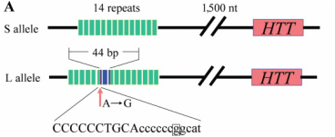
SLC6A4 and OCD
STin9, STin10, STin12
5-HTTLPR: S, LA, and LG
Normal:
Insertion:

Slide 7
SLC6A4 and OCD
STin9, STin10, STin12
5-HTTLPR: S, LA, and LG
Kinase
SLC6A4
Activity

Slide 8
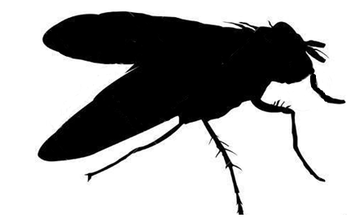
How well is SLC6A4 conserved?
100%
99%
93%
92%
78%
70%
55%
5-HT Transport Domain
Transmembrane Domain

Slide 9
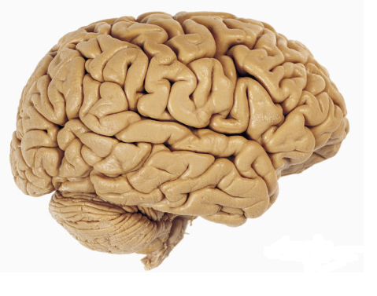
Characteristics of SLC6A4
Serotonin Binding and Reuptake
Brain Development
Synaptosome
Memory
Cocaine Binding
Cytoplasm
Plasma Membrane
Circadian Rhythm
Biological Process
Molecular Function
Cellular Component

Slide 10
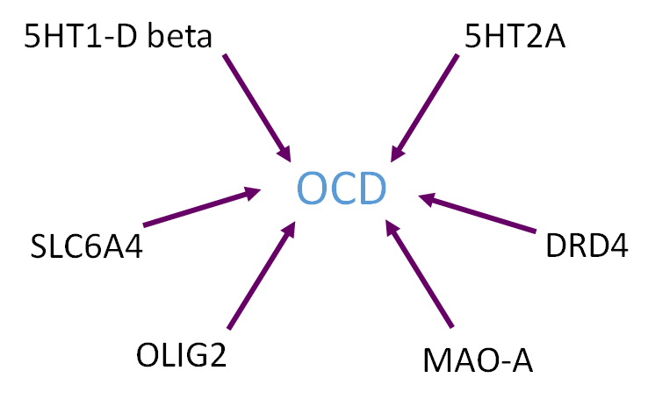
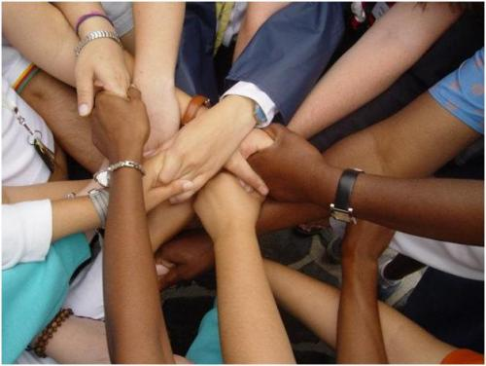
But there is still a long way to go…
OCD is polygenic
Environmental factors - heritability 0.5

Slide 11
Primary Goal: Determine complex interactions between SLC6A4 and other proteins as they relate to development of OCD.
Hypothesis:
Kinase
Protein A
Protein C
Protein B

Slide 12
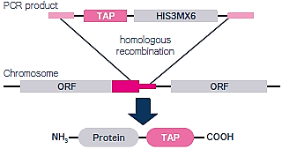
Aim 1: Identify novel and conserved SLC6A4 interacting proteins
Hypothesis: Many undiscovered interactions will be found because of the sensitivity of TAP tag approaches

Slide 13
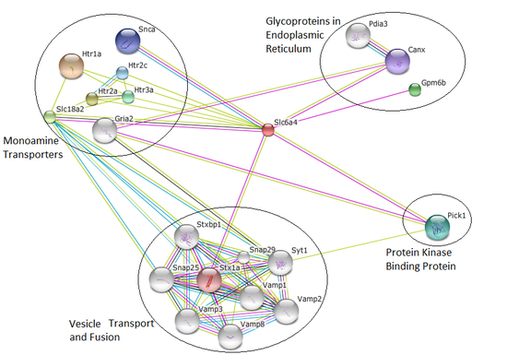
Potential outcomes Aim 1?

Slide 14
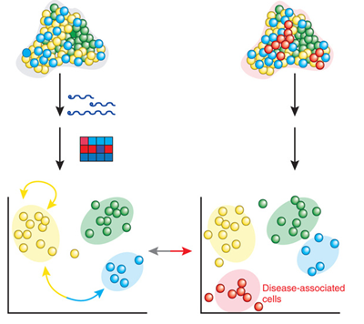
Aim 2: Identify genes that are misregulated in SLC6A4 mutant rats
RNA-seq
Hypothesis: Genes linked to signaling and modification GO terms will be over-expressed in SLC6A4 mutant rats

Slide 15
Potential outcomes of Aim 2?
Brain Development
Memory
Brain Development
Memory
Circadian Rhythm
Circadian Rhythm
Signaling and Modification
Healthy
Mutant

Slide 16
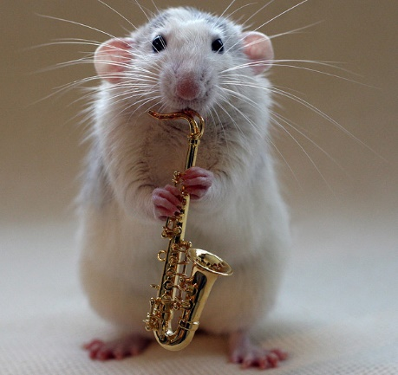
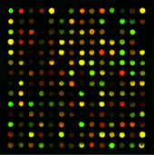
Aim 3: Determine how environmental factors alter the neuronal proteome
Hypothesis: Environmental stressors on healthy mice will cause their proteomes to change and approximate mutant proteomes

Slide 17
Potential outcomes of Aim 3?
Stressed vs.
Healthy
Mutant vs.
Healthy
Healthy

Slide 18
Future Directions?
5-HTTLPR: S, LA, and LG
X
Kinase
Protein A
Protein C
Protein B

Slide 19
References
[1] Kring, A., & Johnson, S. (2013). Obsessive-Compulsive and Related Disorders. In Abnormal Psychology (12th ed. ed., DSM-5 Update, pp. 202-213). Hoboken, N.J.: John Wiley & Sons.
[2] Nestadt, G., Grados, M., & Samuels, J. (2010). Genetics of OCD. Psychiatr Clin North Am, 33(1), 141-158. Retrieved April 15, 2015, from http://www.ncbi.nlm.nih.gov/pmc/articles/PMC2824902/
[3] SLC6A4 - Sodium-dependent serotonin transporter - Homo sapiens (Human). (n.d.). Retrieved February 19, 2015, from http://www.uniprot.org/uniprot/P31645
[4] Ogilvie, A., Battersby, S., Fink, G., Harmar, A., Goodwin, G., Bubb, V., & Smith, C. (1996). Polymorphism in serotonin transporter gene associated with susceptibility to major depression. The Lancet, 347(9003), 731-733. Retrieved February 18, 2015, from http://www.sciencedirect.com.ezproxy.library.wisc.edu/science/article/pii/S0140673696900793
[5] Nakamura, M., Ueno, S., Sano, A., & Tanabe, H. (2000). The human serotonin transporter gene linked polymorphism (5-HTTLPR) shows ten novel allelic variants. Molecular Psychiatry, 5(1), 32-38. Retrieved February 19, 2015, from http://www.nature.com/mp/journal/v5/n1/full/4000698a.html
[6] Ramamoorthy, S., Shippenberg, T., & Jayanthi, L. (2011). Regulation of monoamine transporters: Role of transporter phosphorylation. Pharmacology & Therapeutics, 129(2), 220-238. Retrieved April 14, 2015, from http://www.sciencedirect.com/science/article/pii/S0163725810001932
[6] STRING: http://string-db.org/
[7] BLAST: http://blast.ncbi.nlm.nih.gov/Blast.cgi
[8] Gene Ontology Consortium: http://geneontology.org/
Pictures:
http://www.axisresidentialtreatment.com/obsessive-compulsive-disorder/
https://kiltsdjembesandredboots.wordpress.com/
http://www.anxietydisorderhelp.net/
http://www.youbeauty.com/mind/columns/cloud-nine/calm-the-mind
http://www.guelphtherapist.ca/blog/letting-go-of-thoughts-mindfully/
http://emojipedia.org/relieved-face/
http://myconfidential.blogspot.com/
http://alegnasolutions.com.au/services/psychology/psychologist-gold-coast-anxiety/obsessive-compulsive-disorder/
http://www.fanpop.com/clubs/one-direction/images/32752102/title/one-direction-2012-photo
http://www.bio.davidson.edu/Courses/genomics/2004/Cobain/angergene.html
http://www.bio.davidson.edu/Courses/genomics/2004/Cobain/angergene.html
http://www.gladstoneinstitutes.org/node/11312
http://www.psych2go.net/unconsciousness-neurotransmitters/
http://healthadviser24.blogspot.com/2012/08/neurotransmitters-chemical-messenger-of.html
http://www.allposters.com/-sp/Lateral-View-of-the-Human-Brain-Showing-the-Cerebrum-and-Cerebellum-Posters_i8999883_.htm
http://analytical.wikia.com/wiki/Proteome?file=Proteome.jpg
http://www.koreaittimes.com/image/environment
http://fabandfru.com/2011/06/meet-up-for-business-or-pleasure/
http://accelrys.com/products/pipeline-pilot/component-collections/gene-expression.html
http://www.igece.org/Immunology/ImmArray/
http://dharmacon.gelifesciences.com/non-mammalian-cdna-and-orf/yeast-tap-tagged-orfs/
http://genetics564.weebly.com/gene-expression-analysis.html
http://www.telegraph.co.uk/news/earth/earthpicturegalleries/5893236/Talented-musical-rats-strike-up-a-tune-with-their-miniature-instruments.html
https://www.pinterest.com/pin/138978338473671818/
http://www.pachd.com/free-images/food-images-8.html

