Slide 1
Obsessive Compulsive Disorder and SLC6A4
m
o
Maisie Steinbrink

Slide 2
Game Plan
What is OCD? What causes it?
SLC6A4 and its characteristics
Specific aims and future research

Slide 3
The OCD Cycle
Obsessions
Relief
Anxiety
Compulsions

Slide 4
This obsession doesn’t count ☺
X

Slide 5
Why study OCD?
Depression
OCD
Long-Term Goal: Determine complex interactions between SLC6A4 and other proteins as they relate to development of OCD, because they will likely apply in related disorders as well.

Slide 6
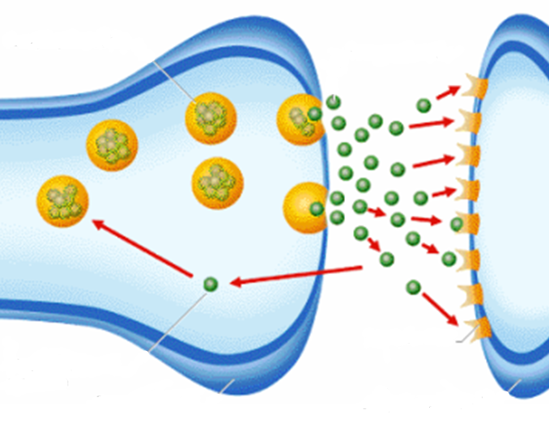
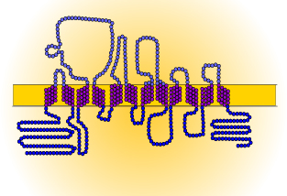
SLC6A4 and OCD
Extracellular
Cytoplasm
Transmembrane Domain
5-HT Transport Domain

Slide 7
Mutations in SLC6A4?
Ile-425Val
Kinase
SLC6A4
Activity

Slide 8
How well is SLC6A4 conserved?
100%
99%
93%
92%
78%
70%
55%
5-HT Transport Domain
Transmembrane Domain

Slide 9
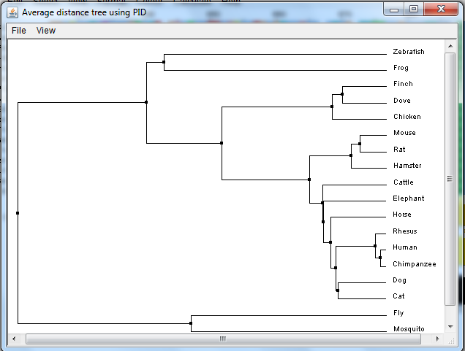
Phylogeny

Slide 10
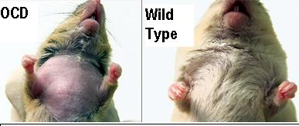
Why use rats?
100%
92%
Conservation
Ritualistic Grooming
Anxiety-like Behaviors

Slide 11
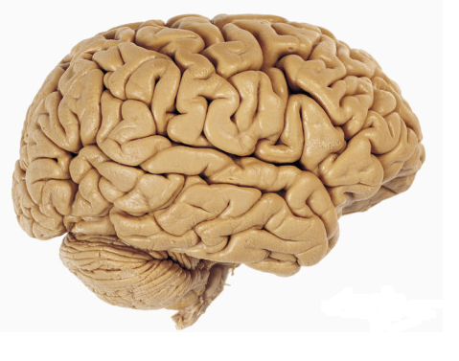
Characteristics of SLC6A4
Serotonin Binding and Reuptake
Brain Development
Synaptosome
Memory
Cocaine Binding
Cytoplasm
Plasma Membrane
Circadian Rhythm
Biological Process
Molecular Function
Cellular Component

Slide 12
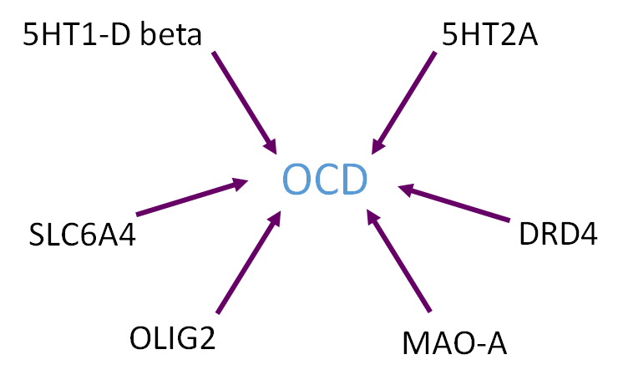
But there is still a long way to go…
OCD is polygenic
Environmental factors - heritability 0.5

Slide 13
Primary Goal: Determine how over-expression of SLC6A4 affects other proteins involved in the development of OCD.
Hypothesis:
Ile-425Val
Kinase
Protein A
Protein C
Protein B

Slide 14
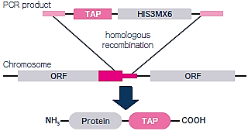
Aims roadmap
Aim 3: Identify alternatively phosphorylated proteins due to interactions with kinases
Aim 1: Identify novel and conserved SLC6A4 interacting proteins
Vs.
Healthy
Aim 2: Identify genes that are misregulated in SLC6A4 mutant rats
Mutant

Slide 15
Aim 1: Identify novel and conserved SLC6A4 interacting proteins
Hypothesis: New interactions found will add several protein kinases to the rat STRING network

Slide 16
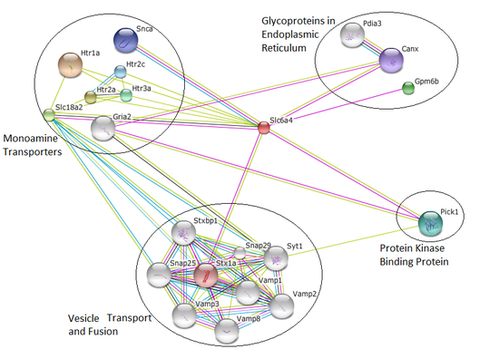
Potential outcomes Aim 1?

Slide 17
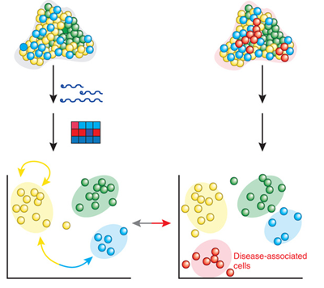
Aim 2: Identify genes that are misregulated in SLC6A4 mutant rats
RNA-seq
Hypothesis: Genes linked to signaling and modification GO terms will be over-expressed in SLC6A4 mutant rats

Slide 18
Potential outcomes of Aim 2?
Brain Development
Memory
Brain Development
Memory
Circadian Rhythm
Circadian Rhythm
Signaling and Modification
Healthy
Mutant

Slide 19
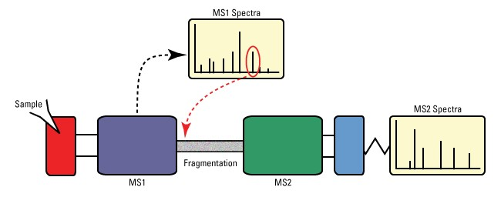
Aim 3: Identify alternatively phosphorylated proteins due to interactions with kinases
Hypothesis: Several proteins that interact with the kinases from Aim 2 will exhibit over-phosphorylation in the mutant sample

Slide 20
Potential outcomes of Aim 3?
+80*
+80*
Healthy
Mutant
*Molecular Weight of Phosphate Group = 80 g/mol

Slide 21
Future Directions?
Ile-425Val
X
Kinase
Protein A
Protein C
Protein B

Slide 22
References
[1] Kring, A., & Johnson, S. (2013). Obsessive-Compulsive and Related Disorders. In Abnormal Psychology (12th ed. ed., DSM-5 Update, pp. 202-213). Hoboken, N.J.: John Wiley & Sons.
[2] Nestadt, G., Grados, M., & Samuels, J. (2010). Genetics of OCD. Psychiatr Clin North Am, 33(1), 141-158. Retrieved April 15, 2015, from http://www.ncbi.nlm.nih.gov/pmc/articles/PMC2824902/
[3] SLC6A4 - Sodium-dependent serotonin transporter - Homo sapiens (Human). (n.d.). Retrieved February 19, 2015, from http://www.uniprot.org/uniprot/P31645
[4] Ogilvie, A., Battersby, S., Fink, G., Harmar, A., Goodwin, G., Bubb, V., & Smith, C. (1996). Polymorphism in serotonin transporter gene associated with susceptibility to major depression. The Lancet, 347(9003), 731-733. Retrieved February 18, 2015, from http://www.sciencedirect.com.ezproxy.library.wisc.edu/science/article/pii/S0140673696900793
[5] Nakamura, M., Ueno, S., Sano, A., & Tanabe, H. (2000). The human serotonin transporter gene linked polymorphism (5-HTTLPR) shows ten novel allelic variants. Molecular Psychiatry, 5(1), 32-38. Retrieved February 19, 2015, from http://www.nature.com/mp/journal/v5/n1/full/4000698a.html
[6] Ramamoorthy, S., Shippenberg, T., & Jayanthi, L. (2011). Regulation of monoamine transporters: Role of transporter phosphorylation. Pharmacology & Therapeutics, 129(2), 220-238. Retrieved April 14, 2015, from http://www.sciencedirect.com/science/article/pii/S0163725810001932
[6] STRING: http://string-db.org/
[7] BLAST: http://blast.ncbi.nlm.nih.gov/Blast.cgi
[8] Gene Ontology Consortium: http://geneontology.org/
Pictures:
http://painmuse.org/?p=345
http://www.axisresidentialtreatment.com/obsessive-compulsive-disorder/
https://kiltsdjembesandredboots.wordpress.com/
http://www.anxietydisorderhelp.net/
http://www.youbeauty.com/mind/columns/cloud-nine/calm-the-mind
http://www.guelphtherapist.ca/blog/letting-go-of-thoughts-mindfully/
http://emojipedia.org/relieved-face/
http://myconfidential.blogspot.com/
http://alegnasolutions.com.au/services/psychology/psychologist-gold-coast-anxiety/obsessive-compulsive-disorder/
http://www.fanpop.com/clubs/one-direction/images/32752102/title/one-direction-2012-photo
http://www.bio.davidson.edu/Courses/genomics/2004/Cobain/angergene.html
http://www.bio.davidson.edu/Courses/genomics/2004/Cobain/angergene.html
http://www.gladstoneinstitutes.org/node/11312
http://www.psych2go.net/unconsciousness-neurotransmitters/
http://ccanhelps.elinkwebdesign.com/aboutNBDs/whatAreNBDs.html
http://healthadviser24.blogspot.com/2012/08/neurotransmitters-chemical-messenger-of.html
http://www.allposters.com/-sp/Lateral-View-of-the-Human-Brain-Showing-the-Cerebrum-and-Cerebellum-Posters_i8999883_.htm
http://analytical.wikia.com/wiki/Proteome?file=Proteome.jpg
http://www.koreaittimes.com/image/environment
http://fabandfru.com/2011/06/meet-up-for-business-or-pleasure/
http://accelrys.com/products/pipeline-pilot/component-collections/gene-expression.html
http://www.igece.org/Immunology/ImmArray/
http://dharmacon.gelifesciences.com/non-mammalian-cdna-and-orf/yeast-tap-tagged-orfs/
http://genetics564.weebly.com/gene-expression-analysis.html
http://www.telegraph.co.uk/news/earth/earthpicturegalleries/5893236/Talented-musical-rats-strike-up-a-tune-with-their-miniature-instruments.html
https://www.pinterest.com/pin/138978338473671818/
http://www.pachd.com/free-images/food-images-8.html

